Slide 1
Canteen Automation App on Android.
Easy and fast, food.

Slide 2
Contents of This Application
Here’s what we have to offer you through this app:
A platform for students of the campus to help receive their food as earliest as possible.
Registration of individual ID’s
User Profile for Self information.
Menu cards to let you order food from any canteen/café/restaurant present anywhere in the campus from your mobile device.
That’s how you’ll do it:
Select from the menu cards of canteen/café/restaurant present in the campus.
Add them to your cart, verify your order.
Pay for the selected and confirm the order.
Receive a token number for the order
Show the token to the restaurant of the order and receive the meal hot and fresh and fast.

Slide 3
01
02
03
Problem vs. Solution
All about the Product
Scope of this project
Why this android application?
A brief description on the project
Overview of the project’s scope

Slide 4
Introduction
In today’s age of fast canteen automation in the canteen, many canteens have chosen to focus on quick preparation and speedy delivery of orders. Until very recently, all of this delivery of orders were placed over the phone, but there are many disadvantages to this system, including the inconvenience of the customer needing to have a physical copy of the menu, lack of a visual confirmation that the order was placed correctly, and the necessity for the canteen to have an employee answering the phone and taking orders.
The main advantage of an online ordering system is that it greatly simplifies the ordering process for both the customer and the canteen. When the customer visits the ordering page of the app, they are presented with an interactive and up-to-date menu, complete with all available options and adjusting prices based on the selected options. After making a selection, the item is then added to their order, which the customer can review the details at any time before checking out. This provides instant visual confirmation of what was selected.
This system also greatly lightens the load on the canteen’s end, as the entire process of taking orders is automated. Once an order is placed on the application, it is entered into the database and then retrieved, in pretty much real-time, by a android-based application on the canteen’s end. Within this application, all items in the order are displayed, along with their corresponding options and delivery details, in a concise and easy to read manner. This allows canteen employees to quickly go through the orders as they are placed and produce the necessary items with minimal delay and confusion.

Slide 5
Problem vs. Solution
01
Students after the class is over, go to food court, order their food, wait for their order, amongst so many orders, by the time the get their order, lunch is over.
By this application, they can order their desired dishes before the lunch break between the classes or during the classes. And when the lunch break happens, they can go to the food court show the received token for their paid order and take the prepared dish right away without any wait.
And enjoy the rest of lunch break the way they want with happy tummies.

Slide 6
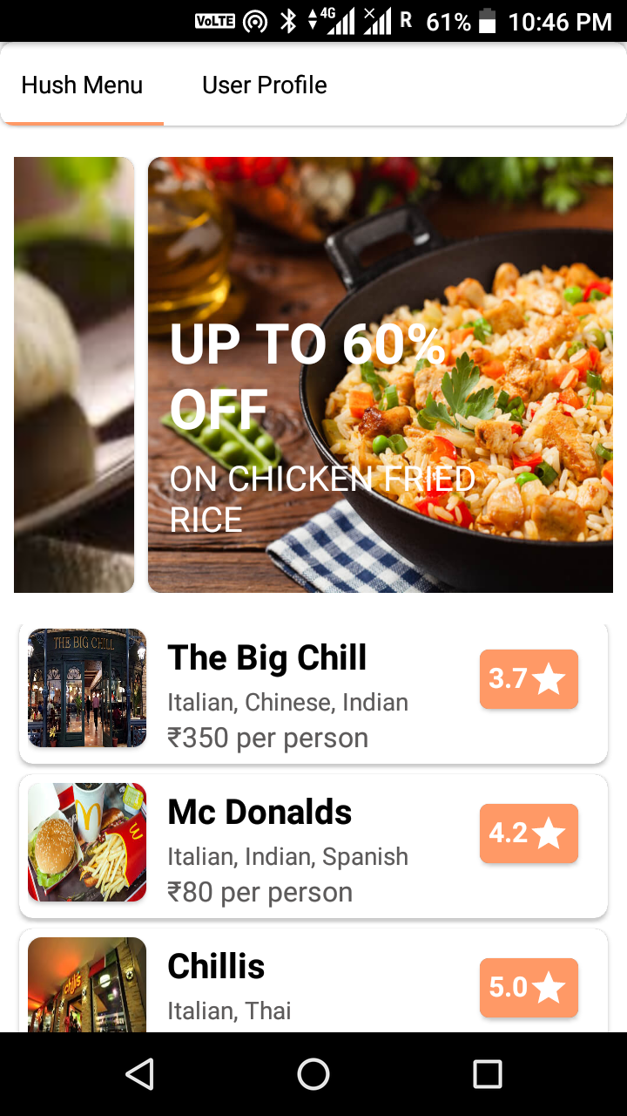
Product Overview
Select
Review
Pay
Order
Generate Reviews on the dishes you tried
Select amongst many dishes campus canteens has to offer
Pay for the ordered through different paying platforms
Order the desired dishes you want

Slide 7
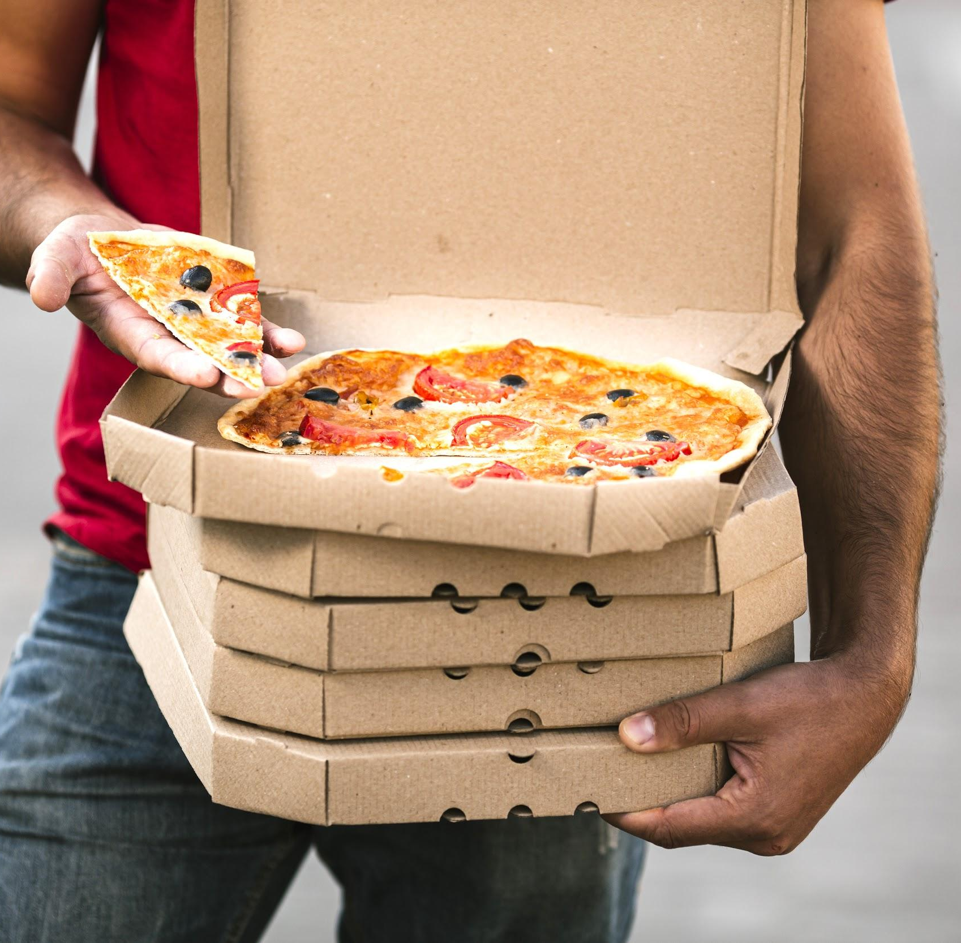
Dishes through easy menu scrolling
Different menus for different canteens.
All the canteen menus in one app and under one thumb.

Slide 8
Reviews
“Hot pot’s momo platter is amazing”
“Didn’t like fries of chowringhee much”

Slide 9
Business Model
Develop
Enhance
Approve
Publish
A developed app for the user side.
We’ll enhance the current app with some finishers.
Approval on the project for further development.
Publish for Students to use.

Slide 10
Our Team
Jatin Vashisht (1/16/FET/BCG/OO3)
Sarthak Agarwal (1/16/FET/BCS/O54)
Parth Dadwal
(1/16/FET/BCG/OO7)
Akshay Gupta
(1/16/FET/BCG/O13)

Slide 11
Thanks!

